Slide 1

K-Means Clustering
Complete Notes with a Full Step by Step Numerical
Machine Learning Lecture
By:Ananda Rimal
Machine Learning Lecture
K-Means
1/13

Slide 2


What is Clustering?
Simple definition
Clustering means dividing data points into homogeneous groups (clusters): points in the SAME group are as similar as possible, points in DIFFERENT groups are as different as possible.
▶ Clustering is unsupervised: the data has NO labels. The algorithm discovers the groups
by itself.
▶ Compare with classification (like KNN or SVM): there we already know the classes. Here
we do not, we are searching for structure.
Everyday examples
Grouping houses by value, type and location. Grouping earthquake zones: areas hit by past earthquakes cluster together, which helps predict where the next one is probable.
Machine Learning Lecture
K-Means
2/13

Slide 3
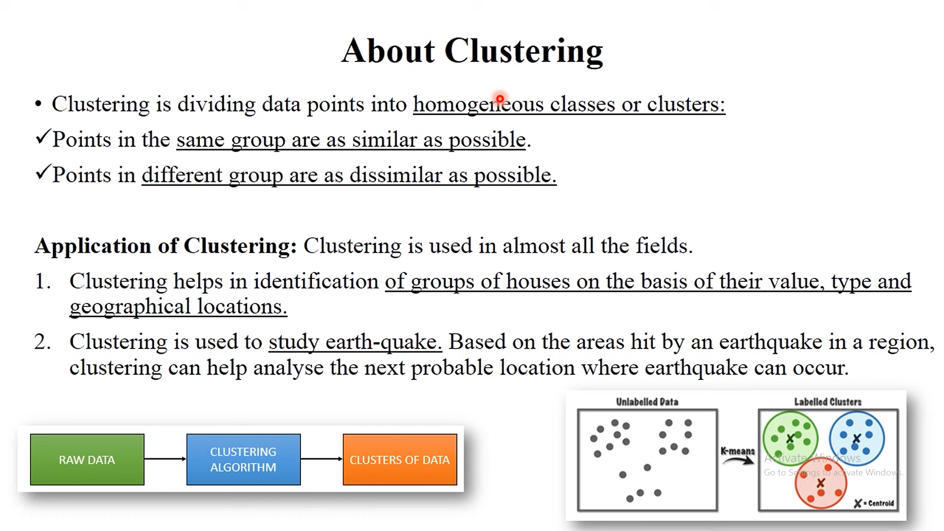

Slide 4
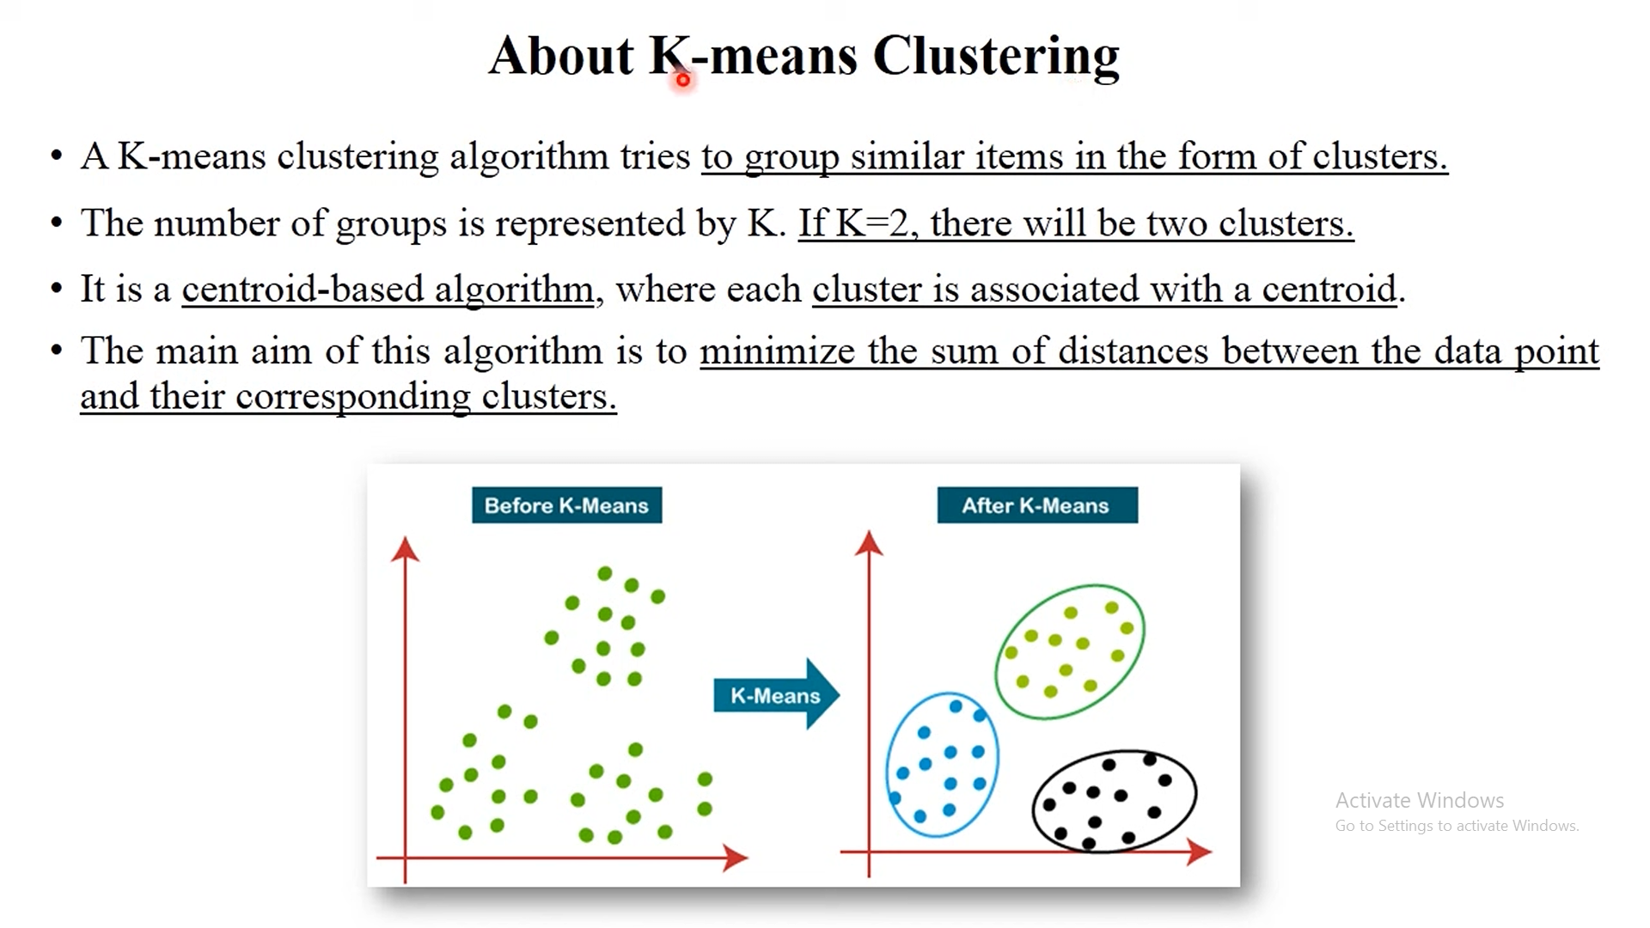

Slide 5
Where is K-Means Used in Real Products?
▶
Customer segmentation: e-commerce and telecom companies cluster customers by spending and behaviour, then target each segment differently. This is the number one industry use of K-means.
Streaming platforms (Spotify, Netflix style): cluster listeners and viewers into taste
groups, then recommend what the rest of the group enjoys.
Image compression (color quantization): reduce a photo to K colors. Every pixel is
replaced by its nearest centroid color. Fewer colors, smaller file.
Ride sharing and delivery (Uber style): cluster pickup locations to decide zones, place
drivers and plan surge areas.
News grouping (Google News style): cluster similar articles so one story shows as a
single group.
Anomaly and fraud detection: a transaction far from ALL centroids fits no normal
group, so it gets flagged.
▶
▶
▶
▶
▶
Machine Learning Lecture
K-Means
4/13

Slide 6
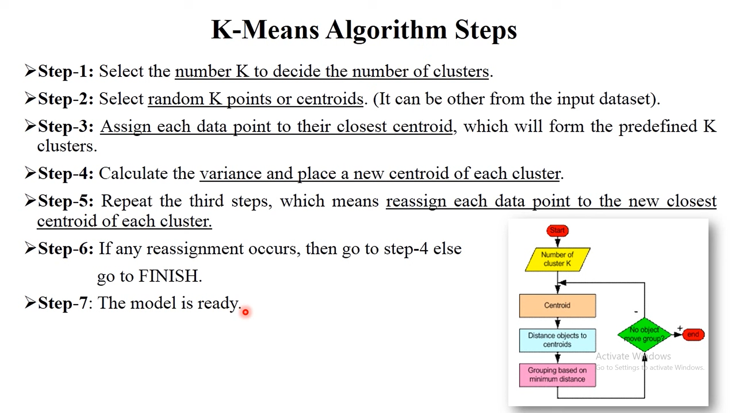

Slide 7
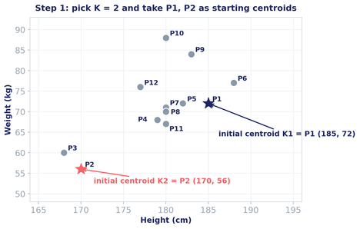
Complete Numerical: The Data
We cluster 12 people by height and weight, with
K
=2.
Person P1
P2
P3
P4
P5
P6
P7
P8
P9
P10
P11
P12
Height 185
170
168
179
182
188
180
180
183
180
180
177
Weight 72
56
60
68
72
77
71
70
84
88
67
76
Start
: K1 = P1 = (185, 72) with group
{P1},
K2 = P2 = (170, 56) with group
{P2}.
Machine Learning Lecture
K-Means
6/13

Slide 8
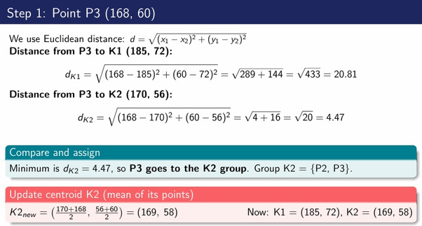

Slide 9
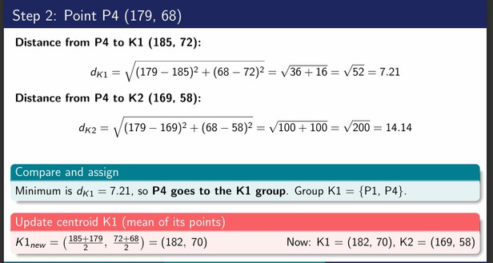

Slide 10
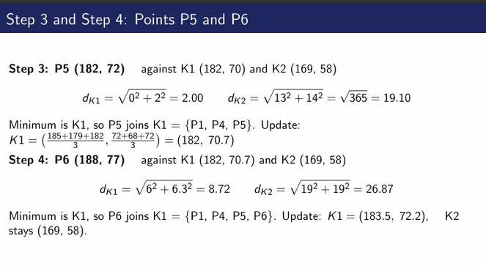

Slide 11
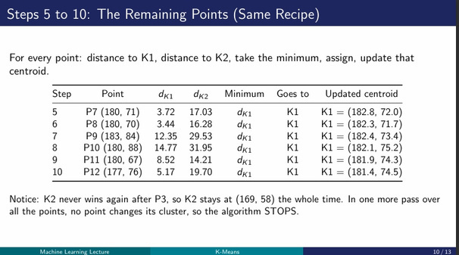

Slide 12
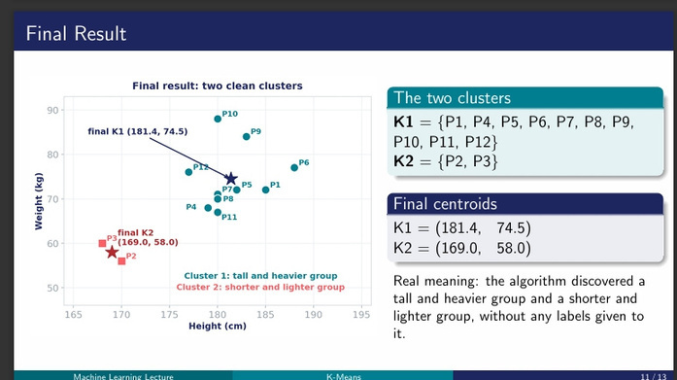

Slide 13
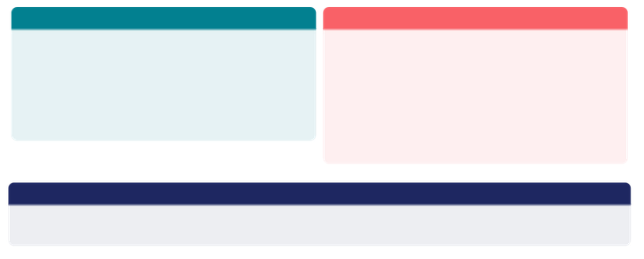
Advantages and Disadvantages
Advantages
Disadvantages
▶ ▶ ▶ ▶
Very simple to implement and explain Scales to huge datasets and runs fast Adapts easily when new examples arrive Works for many shapes and sizes of
clusters
▶
Sensitive to outliers (they drag the centroid)
Choosing K manually is a tough job
Result depends on the starting centroids
Struggles when dimensions become very
many
▶ ▶ ▶
Tip for choosing K
Try several values of K and use the elbow method: plot the total distance for each K, and pick the K where the curve bends like an elbow.
Machine Learning Lecture
K-Means
12 / 13

Slide 14

Summary
Clustering groups unlabeled data: similar points together, different points apart.
K-means is centroid based: every point belongs to its nearest centroid, and the goal is to
minimize the point to centroid distances.
The recipe for each point: distance to K1, distance to K2, take the MINIMUM, assign the
point to that group, and update that centroid to the mean of its points.
Our numerical: starting from K1 = (185, 72) and K2 = (170, 56), only P3 joined K2,
1
2
3
4
{1,4,5,6,7,8,9,10,11,12}, K2 = {2,3}, final
everyone else joined K1. Final clusters: K1 =
centroids (181.4, 74.5) and (169, 58).
Real products use it everywhere: customer segments, taste groups on streaming apps,
image compression, ride sharing zones and fraud detection.
5
Machine Learning Lecture
K-Means
13 / 13

